Slide 1


WHO Information Network for Epidemics
Coronavirus disease (COVID-19)
2019 - 2020
Update #18 20.03.2020

Slide 2
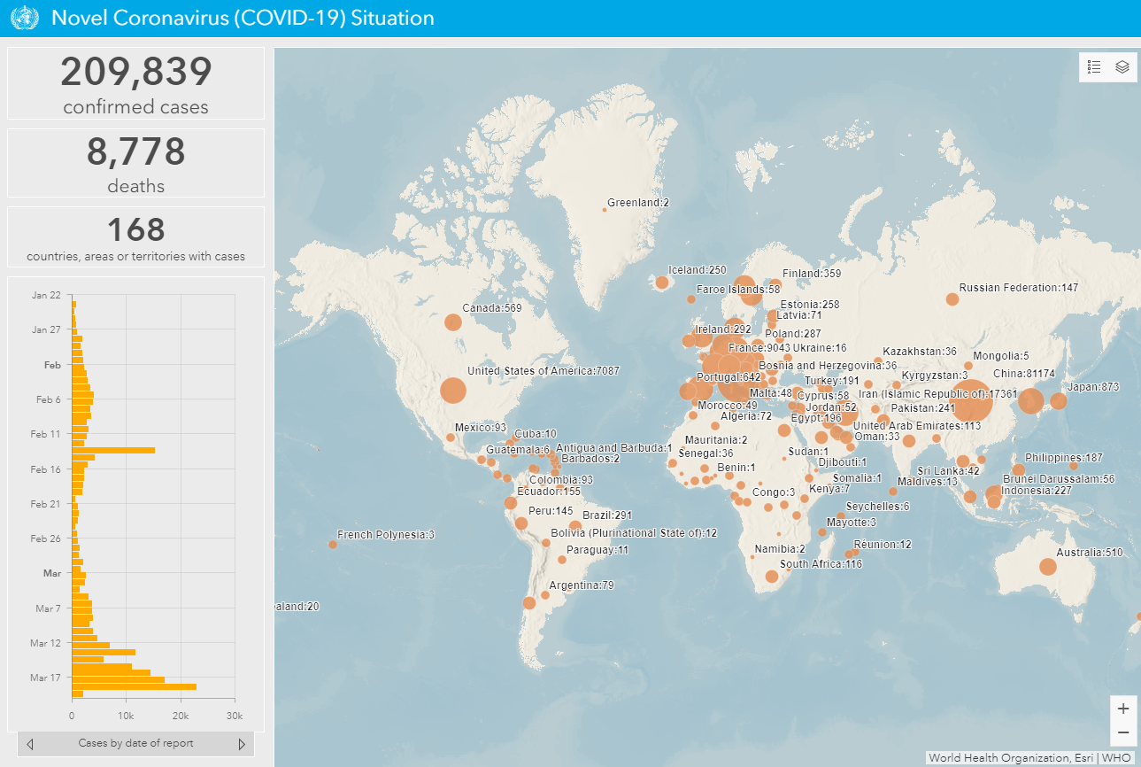
Current Situation
Updates available from the following sources:
WHO situation dashboard
https://experience.arcgis.com/experience/685d0ace521648f8a5beeeee1b9125cd
2. WHO Situation Reports
https://www.who.int/emergencies/diseases/novel-coronavirus-2019/situation-reports
3. UNWFP World Travel Restrictions
http://unwfp.maps.arcgis.com/apps/opsdashboard/index.html#/db5b5df309ac4f10bfd36145a6f8880e
​
Source: WHO

Slide 4
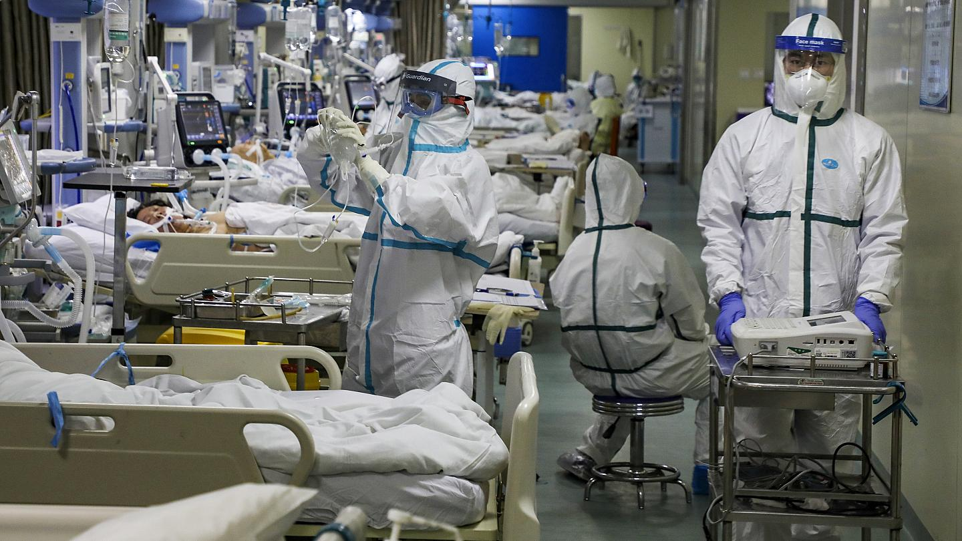
Prepare the health system to face a significant increase in demand for care

Slide 5
Severity profile of COVID-19
Patients need mechanical ventilation
5% critical
15% severe
Patients need oxygen therapy
40% moderate
Pneumonia (potential in patient care required)
40% mild
Patients require isolation
There is no data from populations with high prevalence of HIV, malnutrition etc

Slide 6
Operational considerations for case management of
COVID-19 in health facility and community
Published 19 March 2020 https://apps.who.int/iris/bitstream/handle/10665/331492/WHO-2019-nCoV-HCF_operations-2020.1-eng.pdf

Slide 7
Recommendations for the care of patients based on disease severity
Severity of disease, risk factors | Recommendations
Mild Moderate with no risk factors | Patient self-isolates and calls the COVID-19 information line/health to find out about testing Patient is tested either in health or community facilities Patient remains at home (see guidance on home care for patients)
Moderate, with risk factors Severe Critical | Patient self-isolates and call COVID-19 hotline/emergency services immediate transport to hospital Patient is isolated in hospital and receives inpatient treatment
Risk factors for severe disease: age over 60, hypertension, diabetes cardiovascular disease, chronic respiratory disease, immunocompromising conditions.

Slide 8

Scenario | Health system priorities | Public health measures/ social distancing
1. No reported cases | Do active case finding Prepare all health facilities to screen and assess/triage (see following slides) Prepare designated COVID facilities/wards Set up a COVID hotline | Communicate, communicate, communicate Quarantine and isolation of cases and contacts Individual and family measures - clean hands and cough etiquette, protect the vulnerable Voluntary physical distancing (>1m), staying away from crowded places Conduct risk assessment for large events/gatherings (large sporting events, festivals, conferences, faith-based events) and implement measures to reduce risks Protection measures for special populations/ institutions Adapt and implement stay-at-home measures for: schools & tele-study, workplaces & tele-working, flexible leave policies, staggered shifts public spaces, restaurants, cultural events & entertainment places of worship Adapt or cancel public and private events Cordon sanitaire/movement restrictions Cross-border travel measures Protect food supply and access to care Implement community resilience, mental health strategies Mitigate economic impact
2. Sporadic cases Countries with one or more cases, imported or locally acquired | Do testing and contact tracing Screen and triage at all health facilities Isolate and treat patients in designated facilities/wards
3. Clusters of cases Countries experiencing cases clustered in time, geographic location or common exposure | Screen, triage and treat as above Expand designated treatment areas/hospitals Manage mild/moderate/low risk cases in community settings or at home to avoid over-burdening the health system
4. Community transmission Countries experiencing larger outbreaks of local transmission | In addition to the above, consider new or temporary structures for treating patients Implement a “hub and spoke” referral strategy (next slide) Continue testing as long as possible particularly if cases emerge in new areas. If capacity is limited, consider not testing mild/moderate patients who can self-isolate at home

Slide 9







Screening for COVID-19
SCREEN FOR COVID-19 AT FIRST POINT OF ACCESS TO THE HEALTH SYSTEM USING WHO CASE DEFINITIONS* (fever, cough, dyspnea)
Ambulances
Phone/ telemedicine
Pharmacies
Community health workers
Hospitals, clinics, health posts
People NOT suspected to have COVID-19 follow routine care
People suspected to have COVID-19 are ISOLATED and referred for testing/care
TRIAGE IN A MEDICAL SETTING TO IDENTIFY:
1. COVID-19 PATIENTS IN NEED OF IMMEDIATE CARE,
2. COVID-19 PATIENTS THAT CAN SAFELY WAIT AND
3. COVID-19 PATIENTS THAT NEED TO BE REFERRED TO A SPECIFIC SETTING
*Find WHO case definitions here

Slide 10
Considerations for primary care
Anticipate many patients with respiratory illness
  Make sure everyone knows where to access COVID advice, testing and care
  Coordinate with public health unit/district medical officer, emergency services, clinics, seniors and community care services,
Organize consultations and community care
  Book appointments further apart and book potentially infected patients at the end of the day
  Disallow accompanying persons to appointments (spouse, family) and remove half the chairs from waiting room
  Long-term care - limit multiple facility or cross-practice visits to avoid infecting the elderly
  On rounds, see higher risk/respiratory/feverish patients last, and wear full PPE
  Create referral COVID unit in a single hospital in network, rather than wards in several hospitals
Train yourself and educate your community
  Access courses at https://openwho.org/ and guidance
  Connect with your Ministry of Health, national or local public health unit for information
Protect yourself and staff
  Triage, advise by phone or video (telemedicine)
  Allow receptionists to wear masks or put up a plexiglass screen
  Confirm prescription renewals by phone or other means, or ask pharmacists to extend for routine medicines
  If your practice requires N95 fit testing, don’t delay, get your fit-test done

